Slide 1
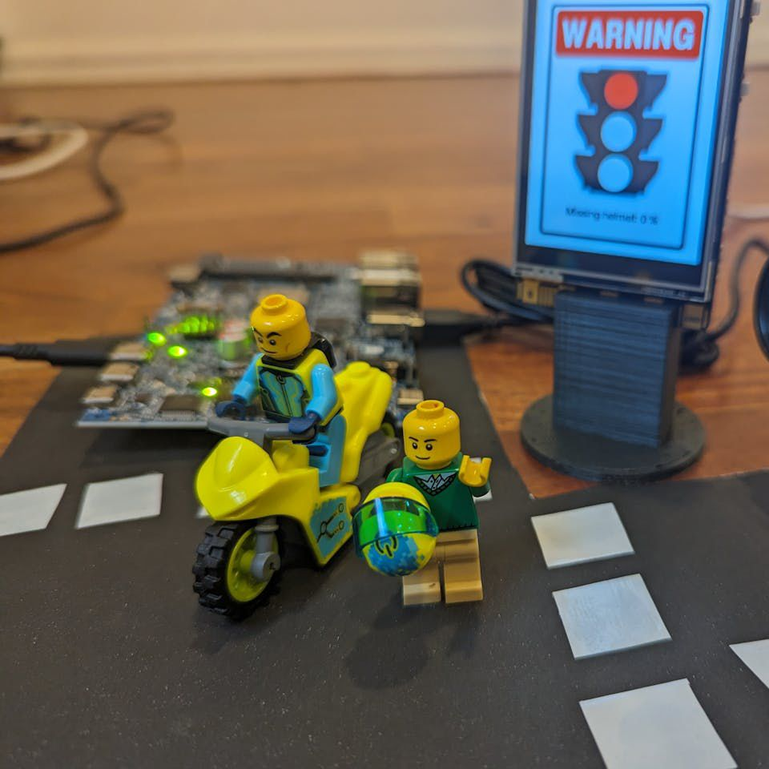
AUTOMATIC HELMET AND NUMBER PLATE RECOGNITION
Presented by
CH.SAI HARSHITHA-21N31A1222
J.SHIVANI-21N31A1263
B.SRIDARSHAN REDDY-21N31A1217
B.SRIKANTH-21N31A1215

Slide 2
ABSTRACT
In traffic management, the accurate recognition of road signs stands as a critical component for enhancing road safety and optimizing traffic flow. However, the variability in environmental conditions, such as lighting and weather, poses significant challenges to existing recognition systems. Conventional methods like traditional Machine learning methods of traffic sign recognition often struggle to adapt to the myriad of scenarios that drivers encounter daily. This has led to a growing need for innovative approaches that can not only handle the complexity of real- world traffic environments but also provide robust and accurate recognition of traffic signs. To address these challenges comprehensively, this approach integrates Convolutional Neural Networks (CNN) with traditional Machine Learning (ML) techniques in a seamless hybrid model for Traffic Sign Recognition.Subsequently, the CNN-extracted features are fed into a traditional Machine Learning (ML) model, refining recognition through contextual information, historical data, and adherence to traffic regulations. The synergy between CNN and ML strengthens the system's accuracy, offering a robust solution for precise traffic sign recognition irrespective of external

Slide 3
INTRODUCTION
PURPOSE OF THE PROJECT:
The helmet is the main safety equipment of motorcyclists. However, many drivers do not use it.
• The main goal of helmet is to protect the drivers head in case of an accident. In such a case, if the motorcyclist does not use a helmet, it can be fatal.
We are dealing with a variety of motorcyclists with distinct colors of clothes, helmets, and angles of motorcyclists.to achieve this, we require a deep neural network that will help to determine the motorcyclist very accurately.
• We mainly aim to collect a database of all the motorcyclists who have violated the rules. One of the key problems we faced was determining whether the person is wearing a helmet or not and to differentiate between biker and pedestrian.
• To avoid these actions, there is need for a system that automatically detects the people who are not wearing a helmet and a system that detects number plates of the motorcycles and extracts the vehicle number which would help find the motorcyclist to be penalize for doing so, we used object detection deep learning Algorithm.

Slide 4
INTRODUCTION
EXISTING AND PROPOSED SYSTEM:
Existing system:
Existing system monitors the traffic violations primarily through CCTV recordings, where the traffic police have to look into the frame where the traffic violation is happening, zoom into the license plate in case rider is not wearing helmet. But this requires lot of manpower and time as the traffic violations frequently and the number of people using motorcycles is increasing day-by-day. What if there is a system, which would automatically look for traffic violation of not wearing helmet while riding motorcycle/moped and if so, would automatically extract the vehicles’ license plate number. In existing Automatic Number Plate Recognition of car presented. But these works are limited with respect to efficiency, accuracy or the speed with which object detection and classification is done. They only used cars in existing work.
Limitations:
This requires lot of manpower and time.
Limited with respect to efficiency.
Limited to only extracting numberplate

Slide 5
INTRODUCTION
PROPOSED SYSTEM
Number Plate Recognition system is a security system. Image processing concept is used in Number Plate Recognition system. OCR scheme is also applied in this for reading the image of vehicle number plate. Number Plate Recognition system is used for many purposes like toll way authorities uses this system for allowing the vehicle to enter the toll road by detecting their number plate automatically and provide them with pay slip and then open the road for that particular car. In this system, firstly we capture the image of the number plate then process it and read each and every character present in the number plate for their perfect recognition. We are considering bikes in this project, if person ware helmet, then it is not recognized, if person not wearing a helmet our system automatically detects number plate of the bike. The main principle involved is Object Detection using Deep Learning at three levels. 11 The objects detected are person, motorcycle/moped at first level using YOLOv2, helmet at second level using YOLOv3, License plate at the last level using YOLOv2. Then the license plate registration number is extracted using OCR
Advantages:
• Injuries can be minimized.
• For accuracy improvement of helmet detection PCA technique is used.

Slide 6
SYSTEM ANALYSIS
HARDWARE REQUIREMENTS
Minimum hardware requirements are very dependent on the particular software being developed
by a given Enthought Python / Canopy / VS Code user. Applications that need to store large arrays/objects in memory will require more RAM, whereas applications that need to perform numerous calculations or Minimum hardware requirements are very dependent on the particular software being developed tasks more quickly will require a faster processor.
Operating system : windows, Linux
Processor : minimum intel i3
Ram : minimum 4 gb
Hard disk : minimum 250gb

Slide 7
SYSTEM ANALYSIS
SOFTWARE REQUIREMENTS:
The functional requirements or the overall description documents include the product perspective and features, operating system and operating environment, graphics requirements, design constraints and user documentation.
The appropriation of requirements and implementation constraints gives the general overview of the project in regards to what the areas of strength and deficit are and how to tackle them.
Python idle 3.7 version (or)
Anaconda 3.7 (or)
Jupiter (or)
Google collab

Slide 8
SYSTEM ANALYSIS
FUNCTIONAL REQUIREMENTS:
Data Collection
Data Preprocessing
Training And Testing
Modeling

Slide 9
SYSTEM DESIGN
SYSTEM ARCHITECTURE:
To distinguish an object from its background, a thresholding segmentation method is used. A predetermined threshold is checked against each picture's pixel value (pixel intensity) during this procedure. A ternary pattern is created when adjacent pixels are joined together following thresholding. The ternary pattern is subdivided into two binary patterns due to the wide range that results from computing a histogram of these ternary values. A description that is twice as big as LBP is created by concatenating histograms. Object recognition is a method for finding and recognizing items in an image or picture sequence. After that, texture-based segmentation and extraction of license plates based on color and characteristics follow.
This is a system for recognizing license plates and helmets. We get photos from a traffic surveillance system and feed them into convolutional neural networks. These organizations give us exact outcomes whether or not the individual is wearing a helmet or not. CNN will be utilized to distinguish the individual's number plate in the event that they are not wearing helmets. These networks are able to correctly identify the biker's number plate characters and produce effective output.

Slide 10
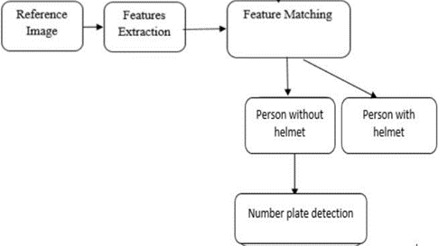
SYSTEM DESIGN
Based on the input picture, the bike was identified using either an IP camera or a webcam. Prior to deciding if the biker is wearing a helmet, this strategy initially decides the picture of the motorcycle and its driver from the picture. In this study, we suggested using picture surveillance data and CNN models to solve the problem of recognizing riders and helmets. We divided the photos we collected for our training dataset into two groups: one for the test data that will be used in the classification experiment, and another for the training data. We tested them using CNN image classification models in this experiment. The accuracy of the rider wearing a helmet and the rider without a helmet identification in the picture not set in stone after all photos are inspected. Convolutional layer neural networks are known as CNNs. and additional layers).

Slide 11
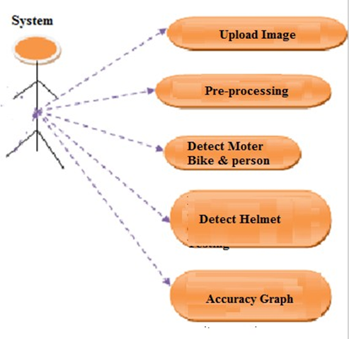
SYSTEM DESIGN
UML DIAGRAMS:
USE-CASE DIAGRAM

Slide 12
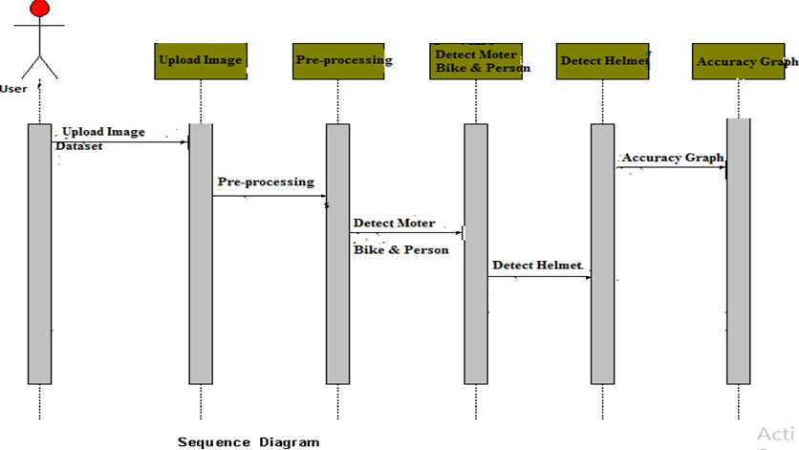
SYSTEM DESIGN
SEQUENCE DIAGRAM:

Slide 13
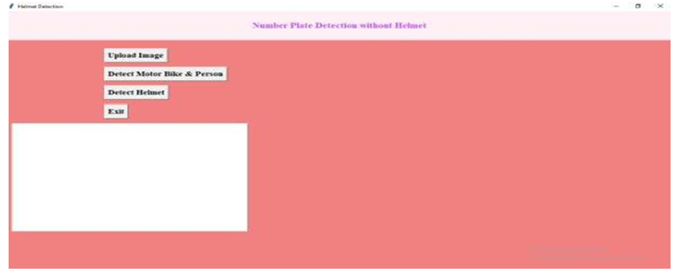
RESULTS
In this project we have built CNN model to detect HELMETS and number plates from 25 different images and we can detect more
images but we don’t have sufficient dataset to train CNN model so our application can detect presence of helmet from 25 different images and if helmet not present then it will identify number plate and if helmet detected then it will not identify number plate.
To run project double click on ‘run.bat’ file to get below screen.

Slide 14
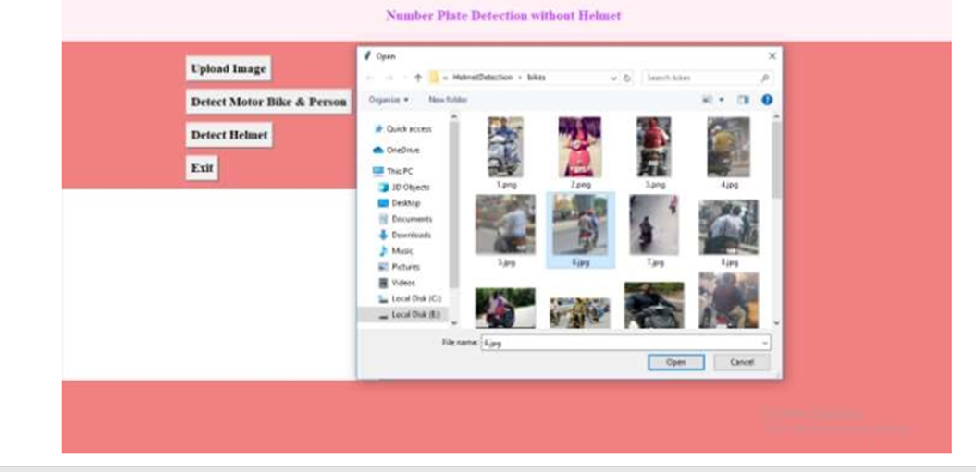
RESULTS
In above screen click on ‘Upload Image’ button to upload image

Slide 15
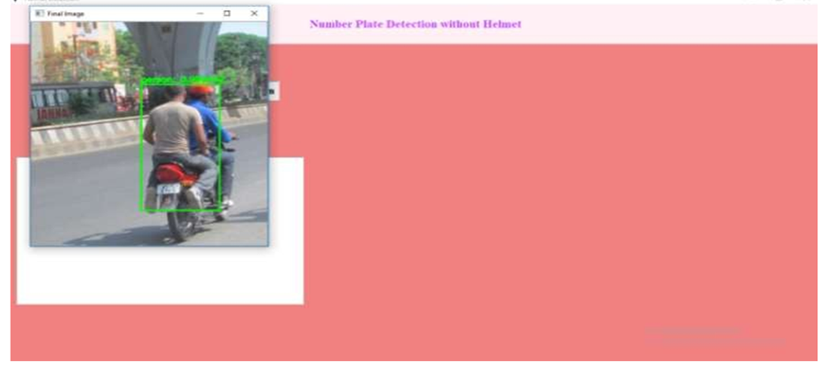
RESULTS
In above screen selecting and uploading ‘6.jpg’ file and then click on ‘Open’ button to load image and then click on ‘Detect Motor Bike & Person’ button to detect whether image contains person with bike or not.

Slide 16
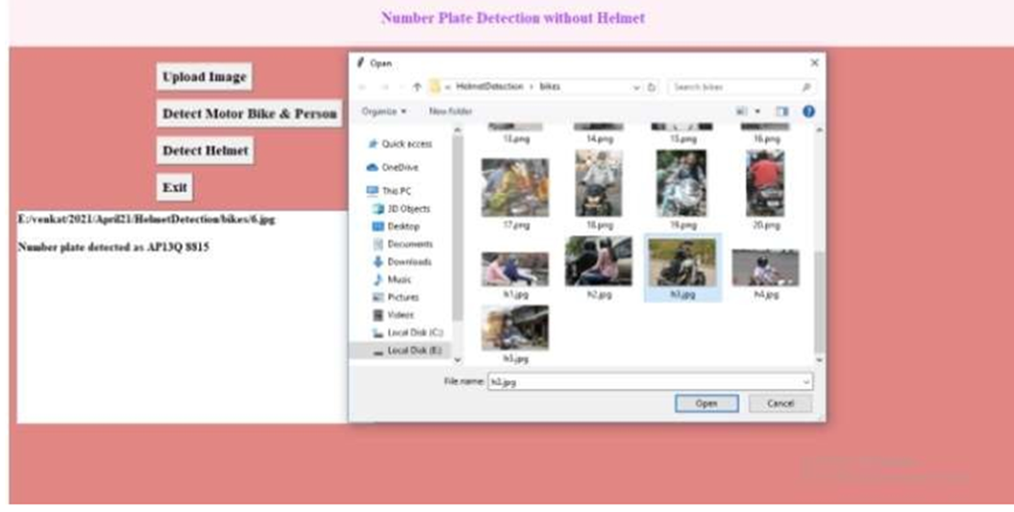
RESULTS
In above screen we can see helmet not detected and then application
identify number plate and display on the text area as ‘AP13Q 8815’. Now try with other image by uploading it.

Slide 17
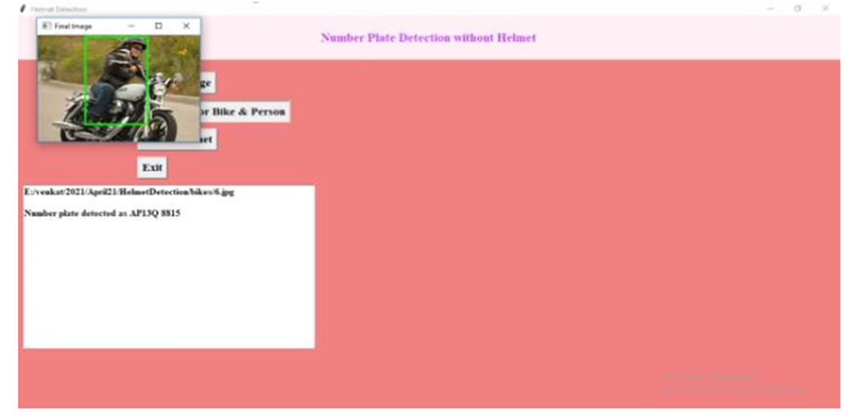
RESULTS
In above screen selecting and uploading ‘h3.jpg’ file and then click on ‘Open’ button then click on ‘Detect Motor Bike & Person’ button to get below result.

Slide 18
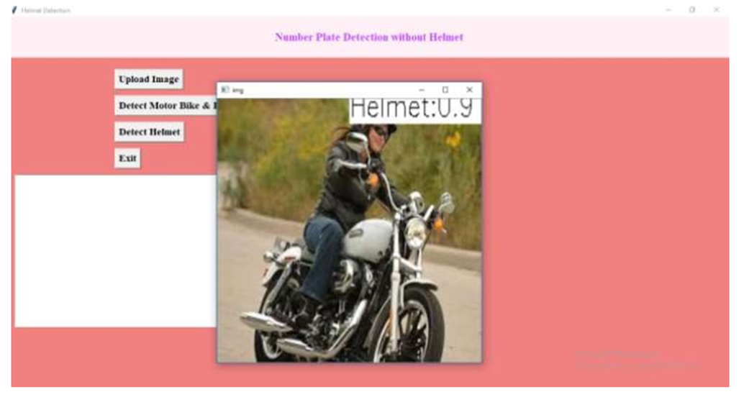
RESULTS
In above screen person with motor bike detected and now close above image and then click on ‘Detect Helmet’ button to get below.

Slide 19
CONCLUSION
CONCLUSION
In this review, we present a technique for distinguishing bike riders who don't wear helmets disregarding transit regulations. Moreover, the proposed structure would make it simpler for policemen to get these hoodlums in uncommon conditions like the burning sun. The results of the experiment show that violators and bike riders can be accurately identified. In addition, the suggested architecture automatically adjusts to new circumstances with minimal modification.
FUTURE SCOPE
We want to include video frames in the future to extend this idea. Movies can also be used to identify number plates without helmets.

Slide 20
REFERENCES
A. Adam, E. Rivlin, I. Shimshoni, and D. Reinitz, “Robust real- time unusual event detection using multiple fixed-location monitors,” IEEE Transactions on Pattern Analysis and Machine Intelligence, vol. 30, no. 3, pp. 555–560, March 2008.
B. Duan, W. Liu, P. Fu, C. Yang, X. Wen, and H. Yuan, “Real-time on road vehicle and motorcycle detection using a single camera,” in Procs. of the IEEE Int. Conf. on Industrial Technology (ICIT), pp. 1– 6, 10-13 Feb 2009.
C.-C. Chiu, M.-Y. Ku, and H.-T. Chen, “Motorcycle detection and tracking system with occlusion segmentation,” in Int. Workshop on Image Analysis for Multimedia Interactive Services, Santorini, pp. 32–32 June 2007.
W. Hu, T. Tan, L. Wang, and S. Maybank, “A survey on visual surveillance of object motion and behaviors,” IEEE Transactions on Systems, Man, and Cybernetics, Part C: Applications and Reviews, vol. 34, no. 3, pp. 334S–352, Aug 2004.
J. Chiverton, “Helmet presence classification with motorcycle detection and tracking,” Intelligent Transport systems (IET), vol. 6, no. 3, pp. 259–269, September 2012.

Slide 21


